Slide 1



Slide 2
!VoidLab has its eyes in the future, always capturing the market trends and technological needs of the customer.
Our Business Analyst team seeks to understand your business in order to create a product that is aimed at you, with your resources in mind.
We aim to combine our skills in technology, multimedia and services in order to offer a product with the highest quality. With tailormade and fully customized solutions, we accompany the customer throughout the process as well as after its launch, ensuring a mechanism of support.

Slide 3
Our vision lies in supporting our clients in such a way that they can break through the technology market through innovation, consolidating them in the leadership.

Slide 4
Our value proposition lays on the delivery of unique solutions, following our core goal of value creation to our client and company. The capacity of market adaptability of !VoidLab is a key point.

Slide 5


Slide 6
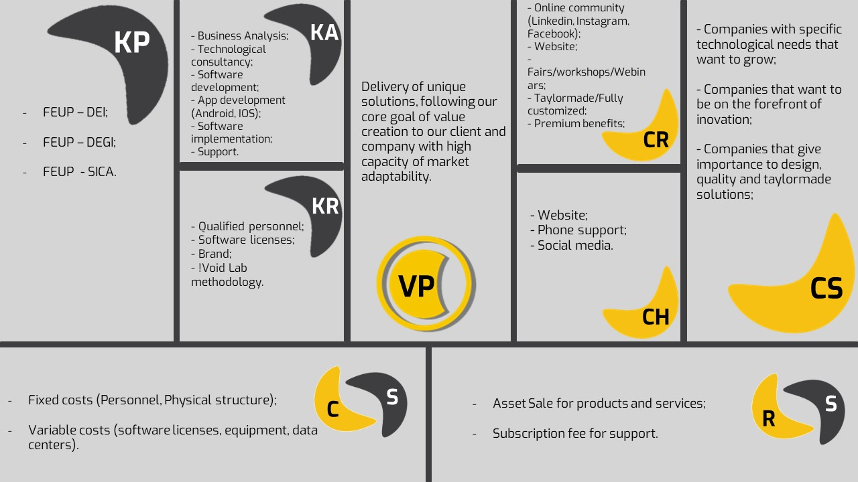

Slide 7
GNet

Slide 8
Product & Problem
Every year many medical study cases are published and presented in conferences. gNet seeks to create a network for professionals on the Health industry to post, share and discuss their studies, creating a community that is actively involved in the sharing of medical knowledge. Furthermore, this will allow the streaming of conferences to enable people that cannot attend them to participate.

Slide 9
Business Objective
The objective of this project is to create a network encompassing the medical community, that functions as a common point of knowledge sharing for the community. This way, the clinical case articles can all be shared in a common place, easing their search, share and discussion.
Active users in the community will be rewarded, keeping them interested and involved in the community.
There will exist rankings associated to publications and users, which will play a decisive factor in deciding which publications will appear in a user’s feed. This way, we can ensure the user receives the posts with the best content.

Slide 10
Project Documentation
SRS
Module I - Clinical case sharing
Module II - Interaction amongst users
Module III - Ranking system
Module IV - Conferences
Module V - Shop
ATP
Tools for testing:
Enzyme
Jest
react-testing-library
React-unit
Skin-deep
Unexpected-react
Cypress
Selenium WebDriver
Mocha
Protractor

Slide 11
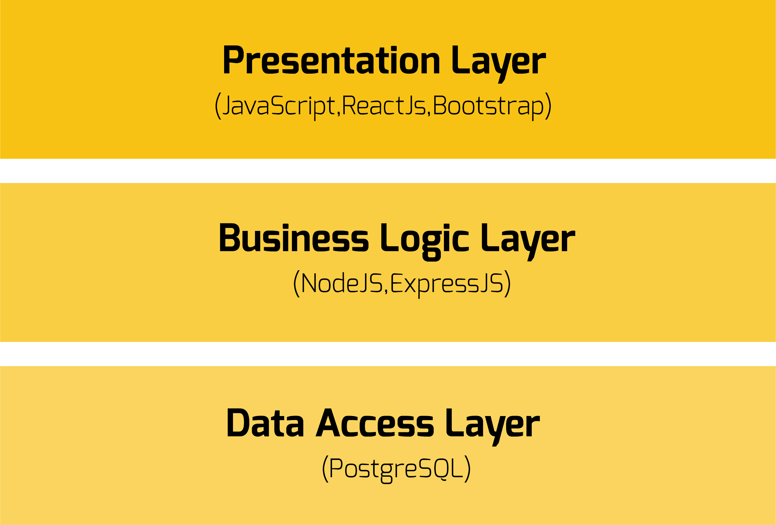
SAD
Layer View

Slide 12
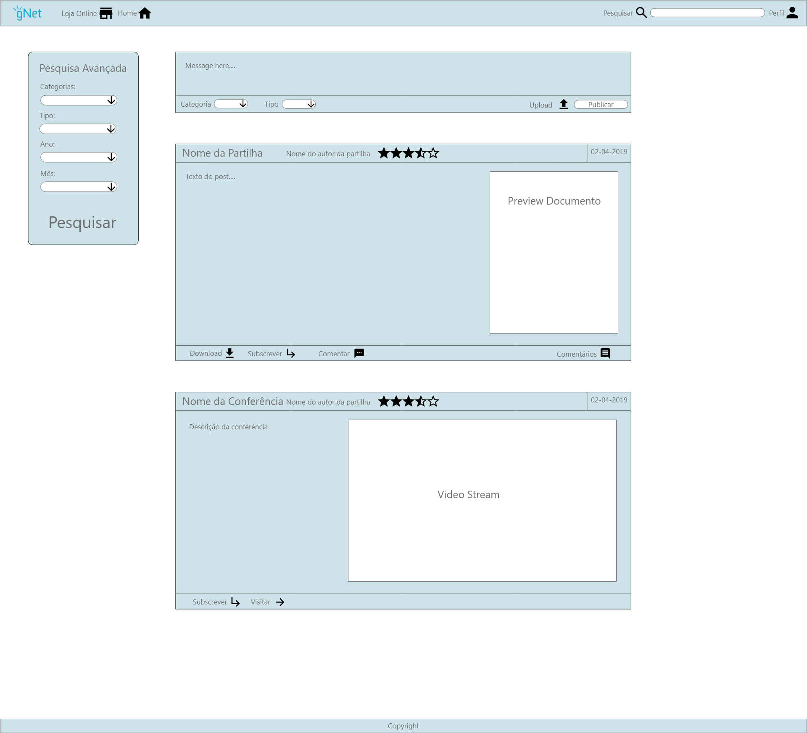
Prototype
Main Page

Slide 13
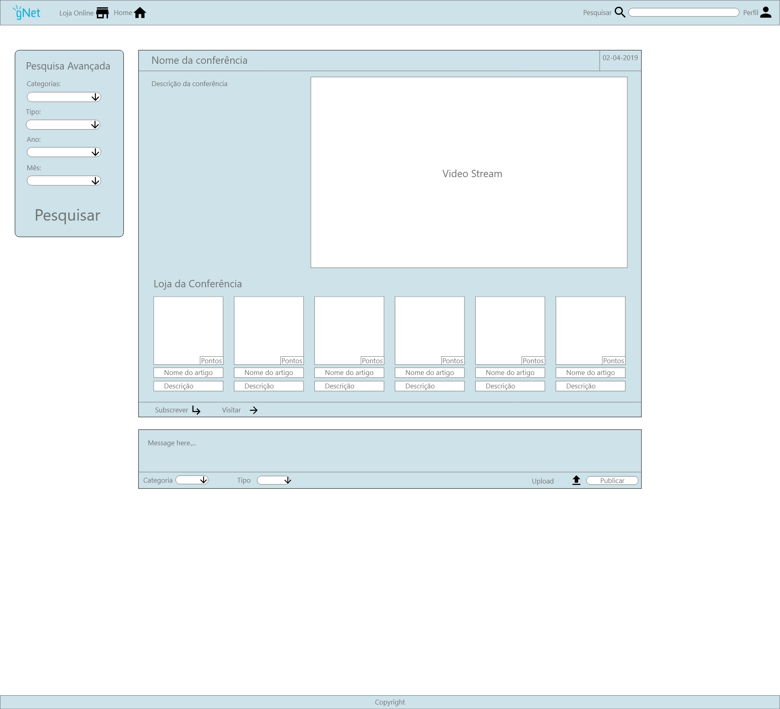
Prototype
Conference Page

Slide 14
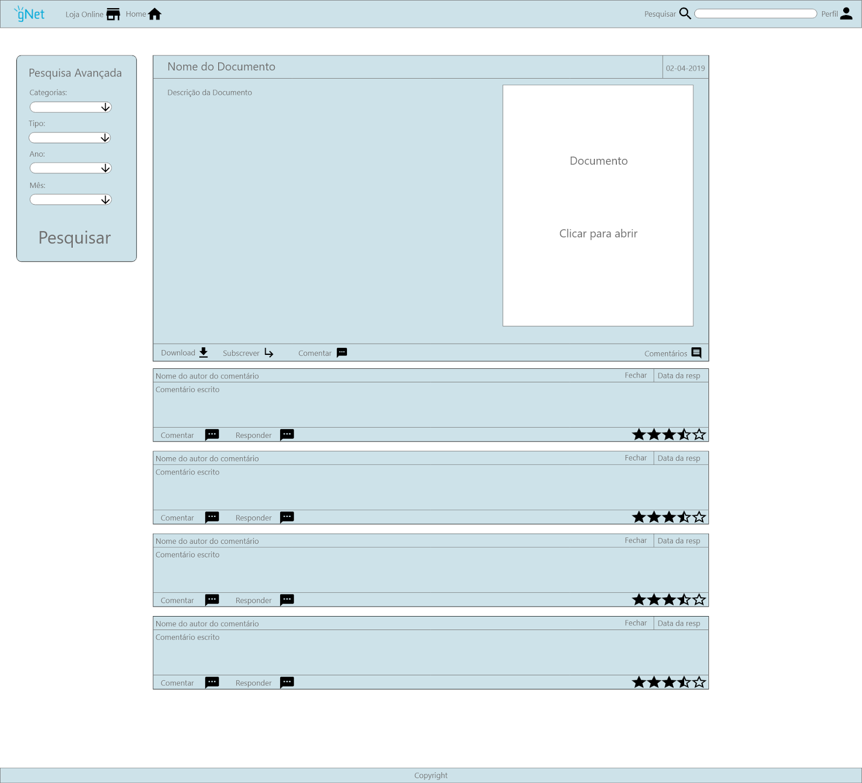
Prototype
Document Page

Slide 15
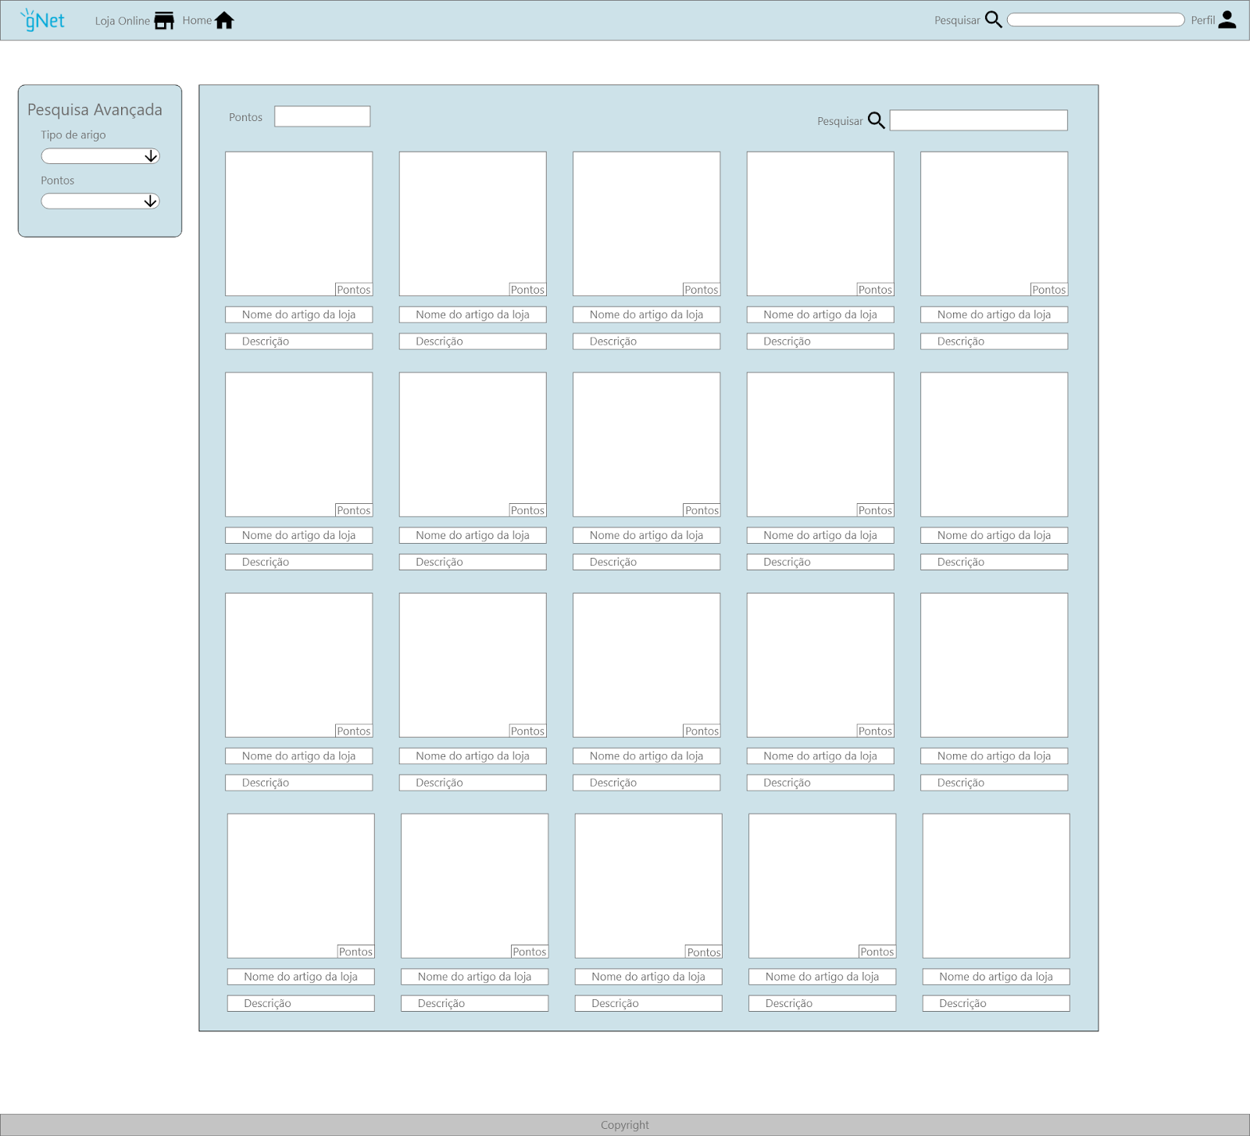
Prototype
Store

Slide 16
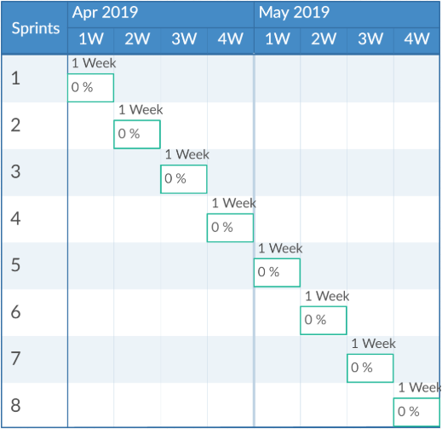
Project Update
The development cycle is divided in weekly sprints.
The finished features are published to ‘master’ server at the end of each sprint.
A staging server will be used to present the continued development efforts to our clients.

Slide 17
Porto Oculto

Slide 18
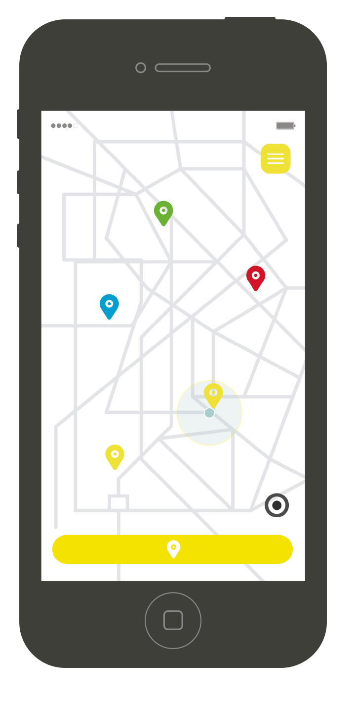
Product & Problem
In Porto there are many buildings and areas that are abandoned. With the app people can identify these buildings and areas so they can be renovated, making the city even more beautiful and preserved.
Mobile Application: iOS and Android

Slide 19
Business Objective
1. Map spaces and buildings that are empty, in ruins or abandoned from the city of Porto;
2. Conscientialize for urban rehabilitation;
3. Identify buildings of architectural interest;

Slide 20
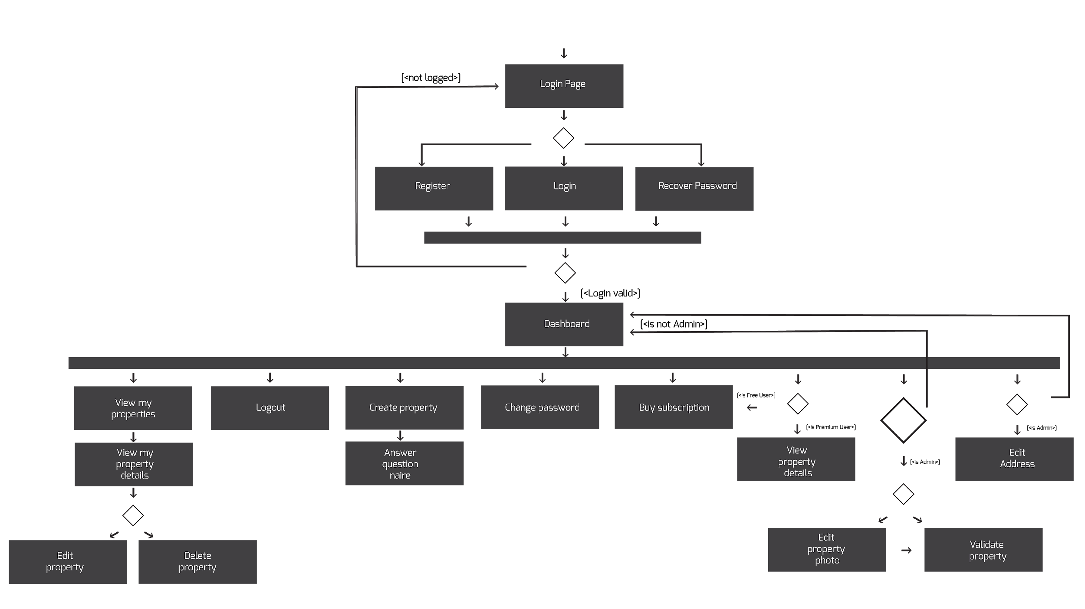
Project Documentation
SRS

Slide 21
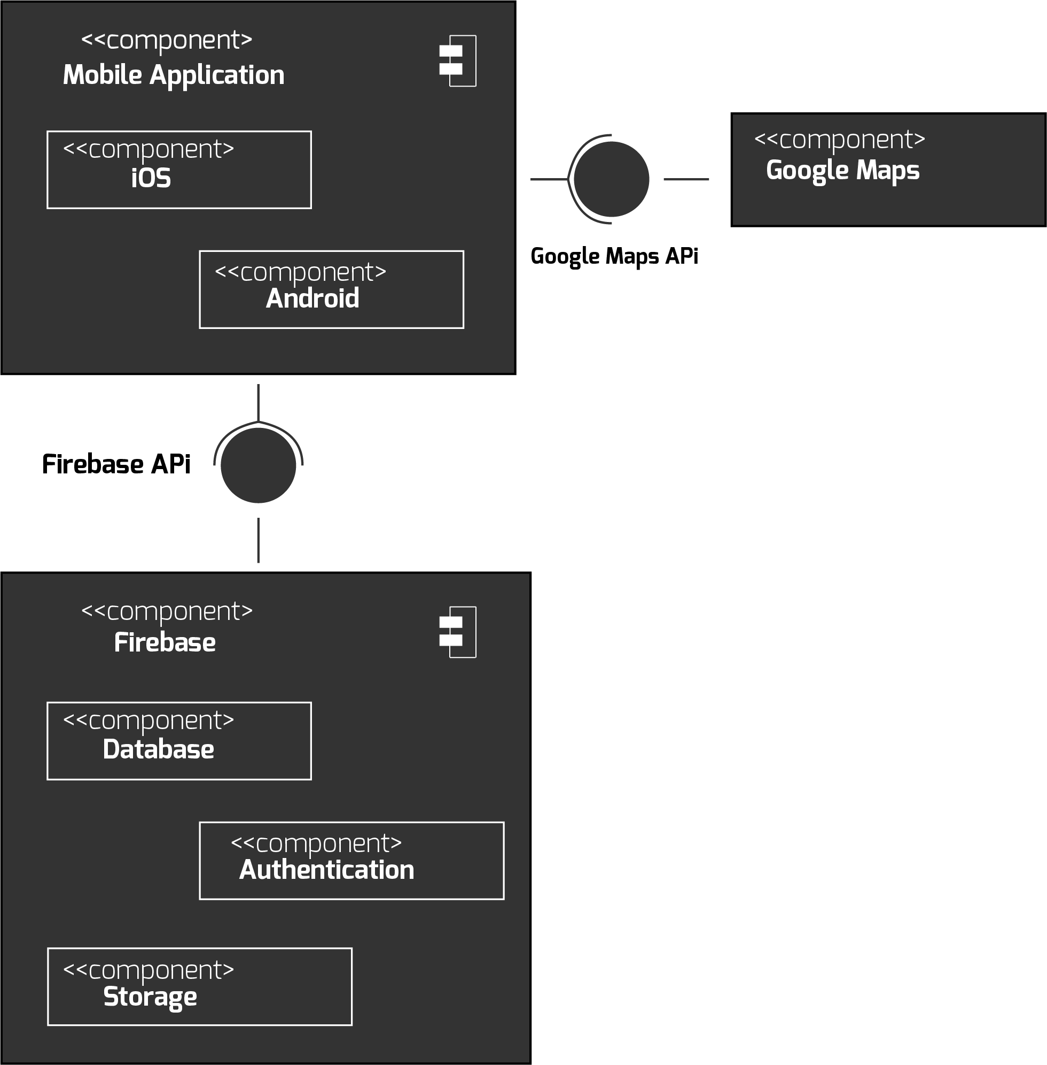
Project Documentation
ATP
_Sprint Testing
_Alpha Testing
_Beta Testing
_UI Testing
_Stress Testing (Jmeter)
_Load Testing (Jmeter)
SAD

Slide 22
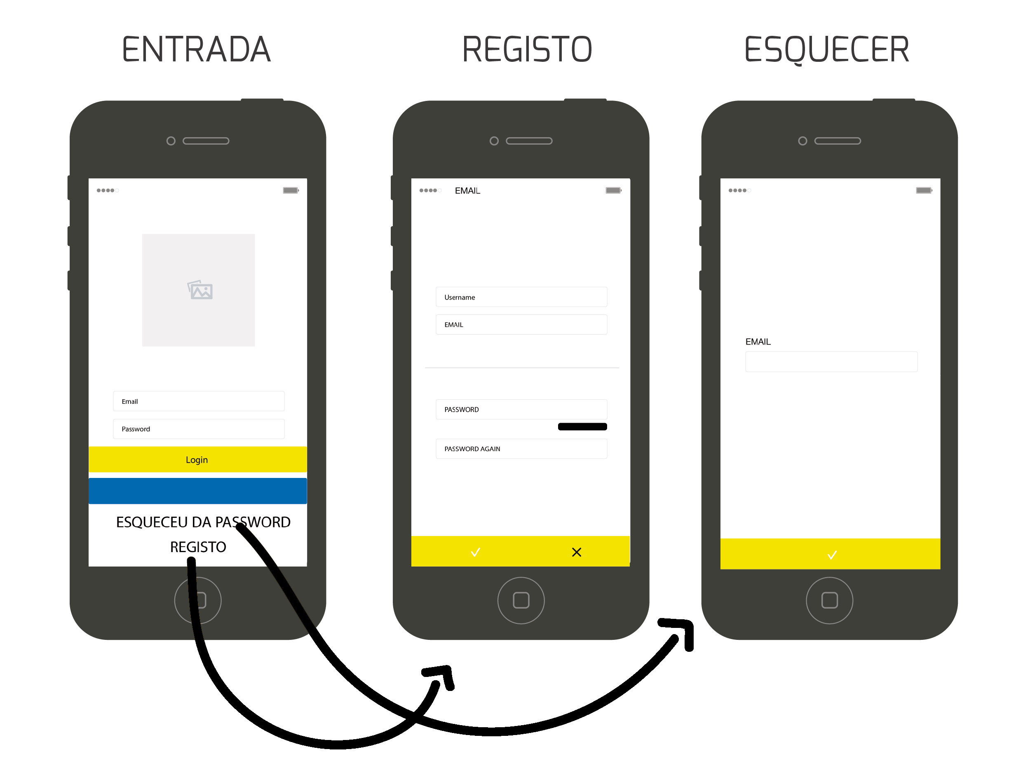
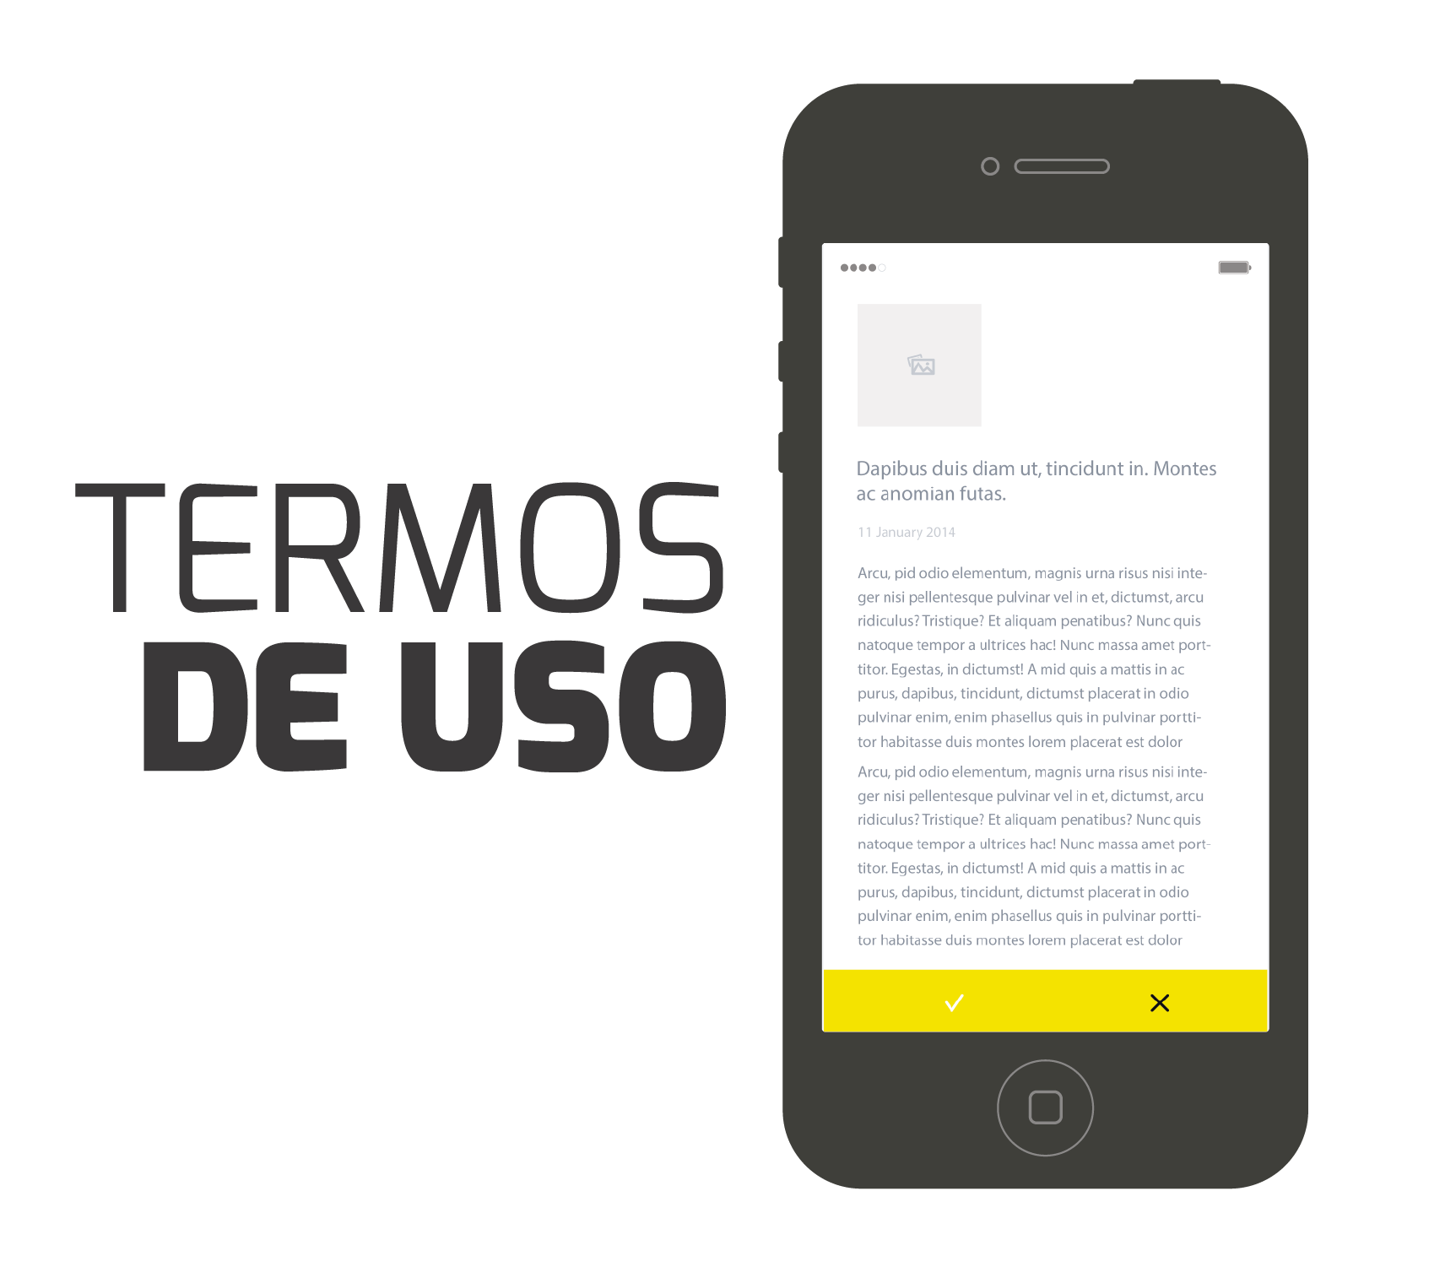
Prototype

Slide 23
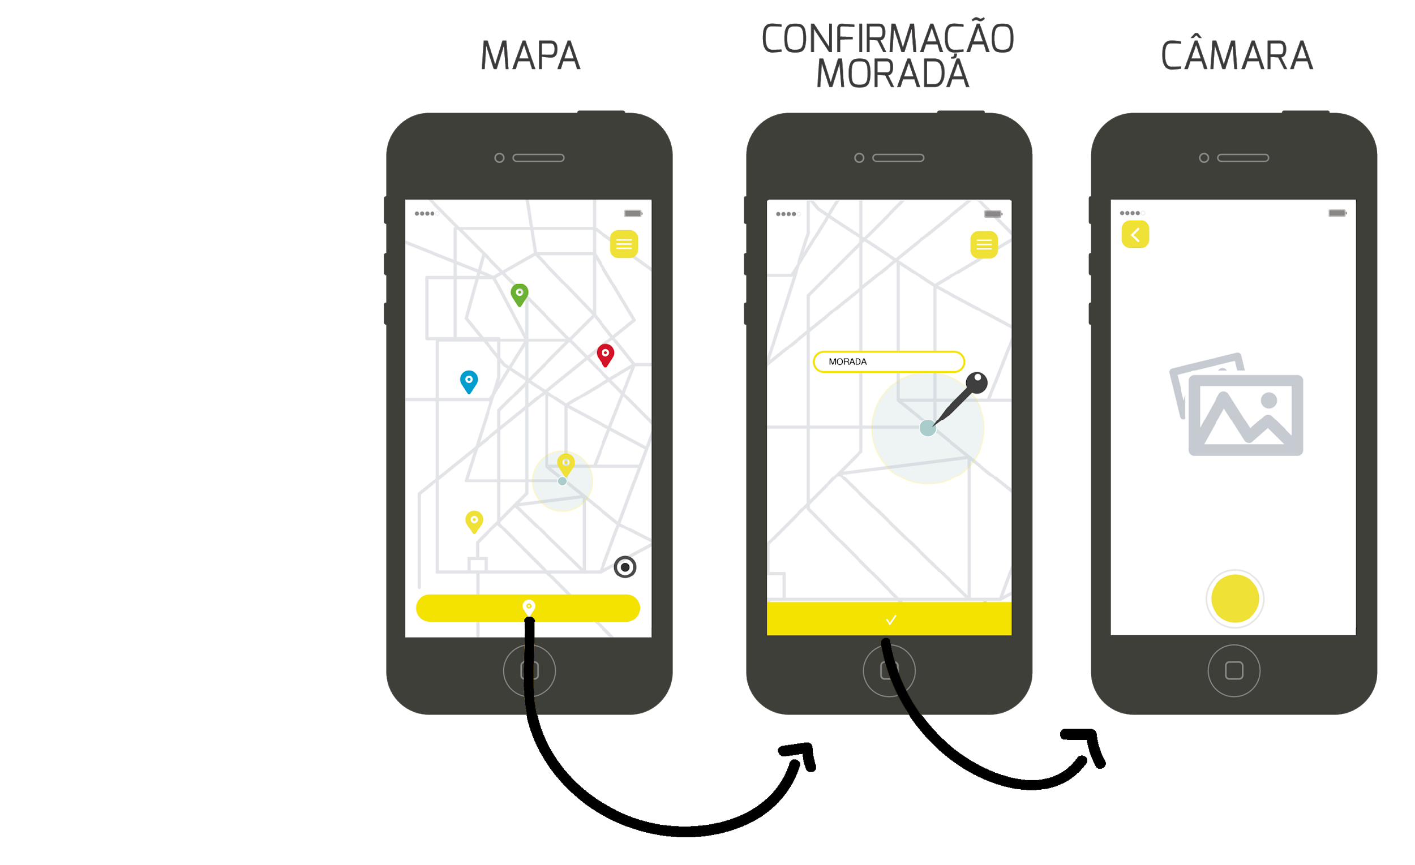
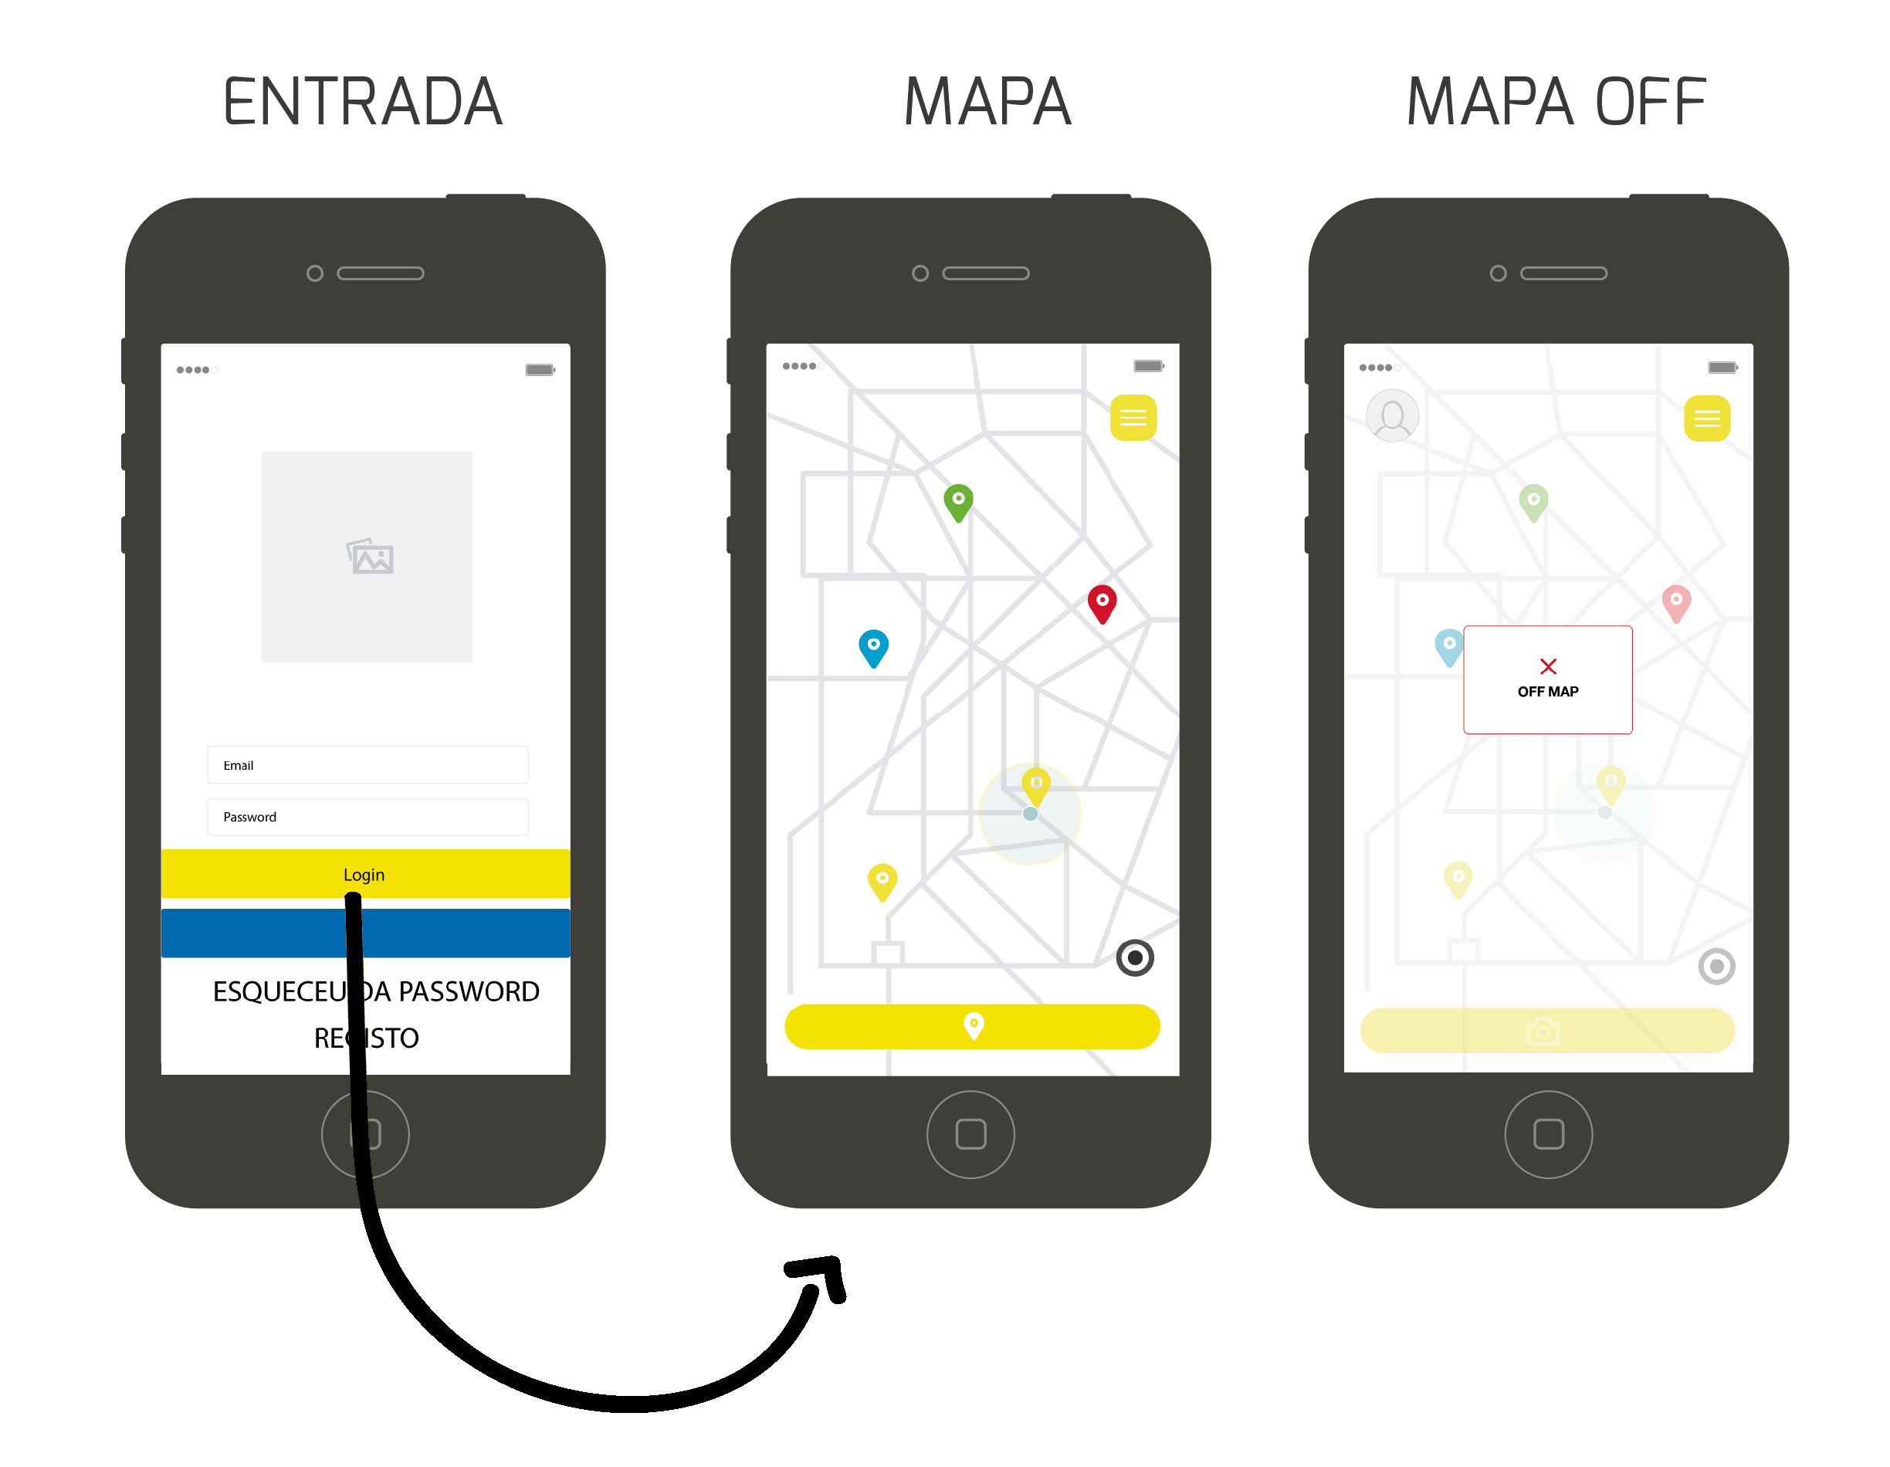
Prototype

Slide 24
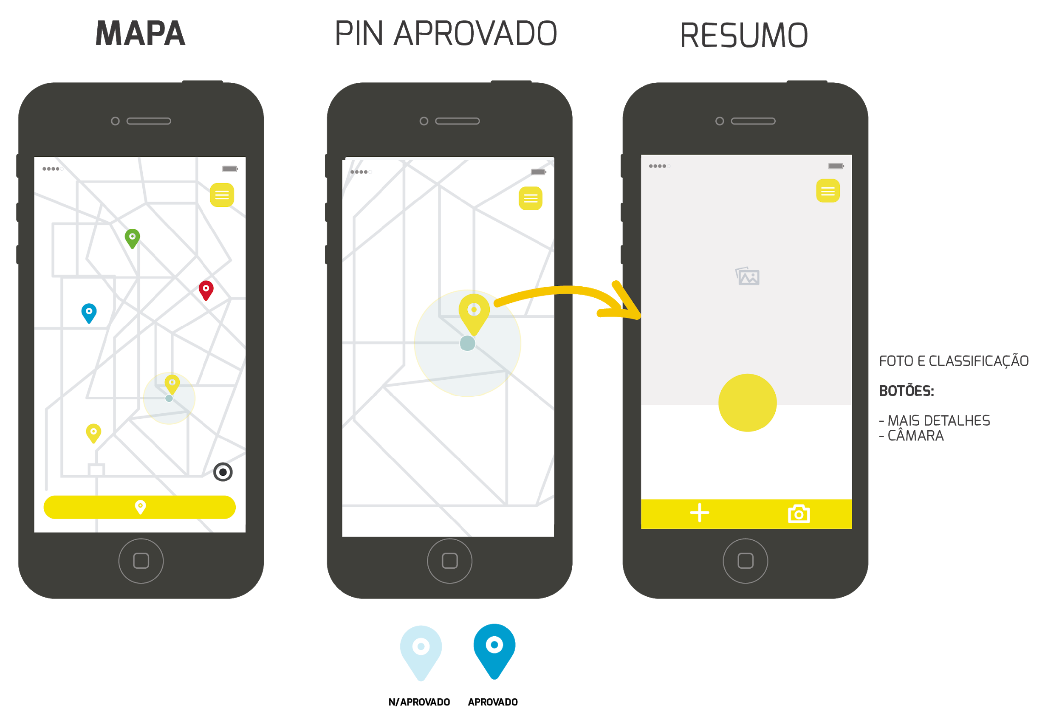
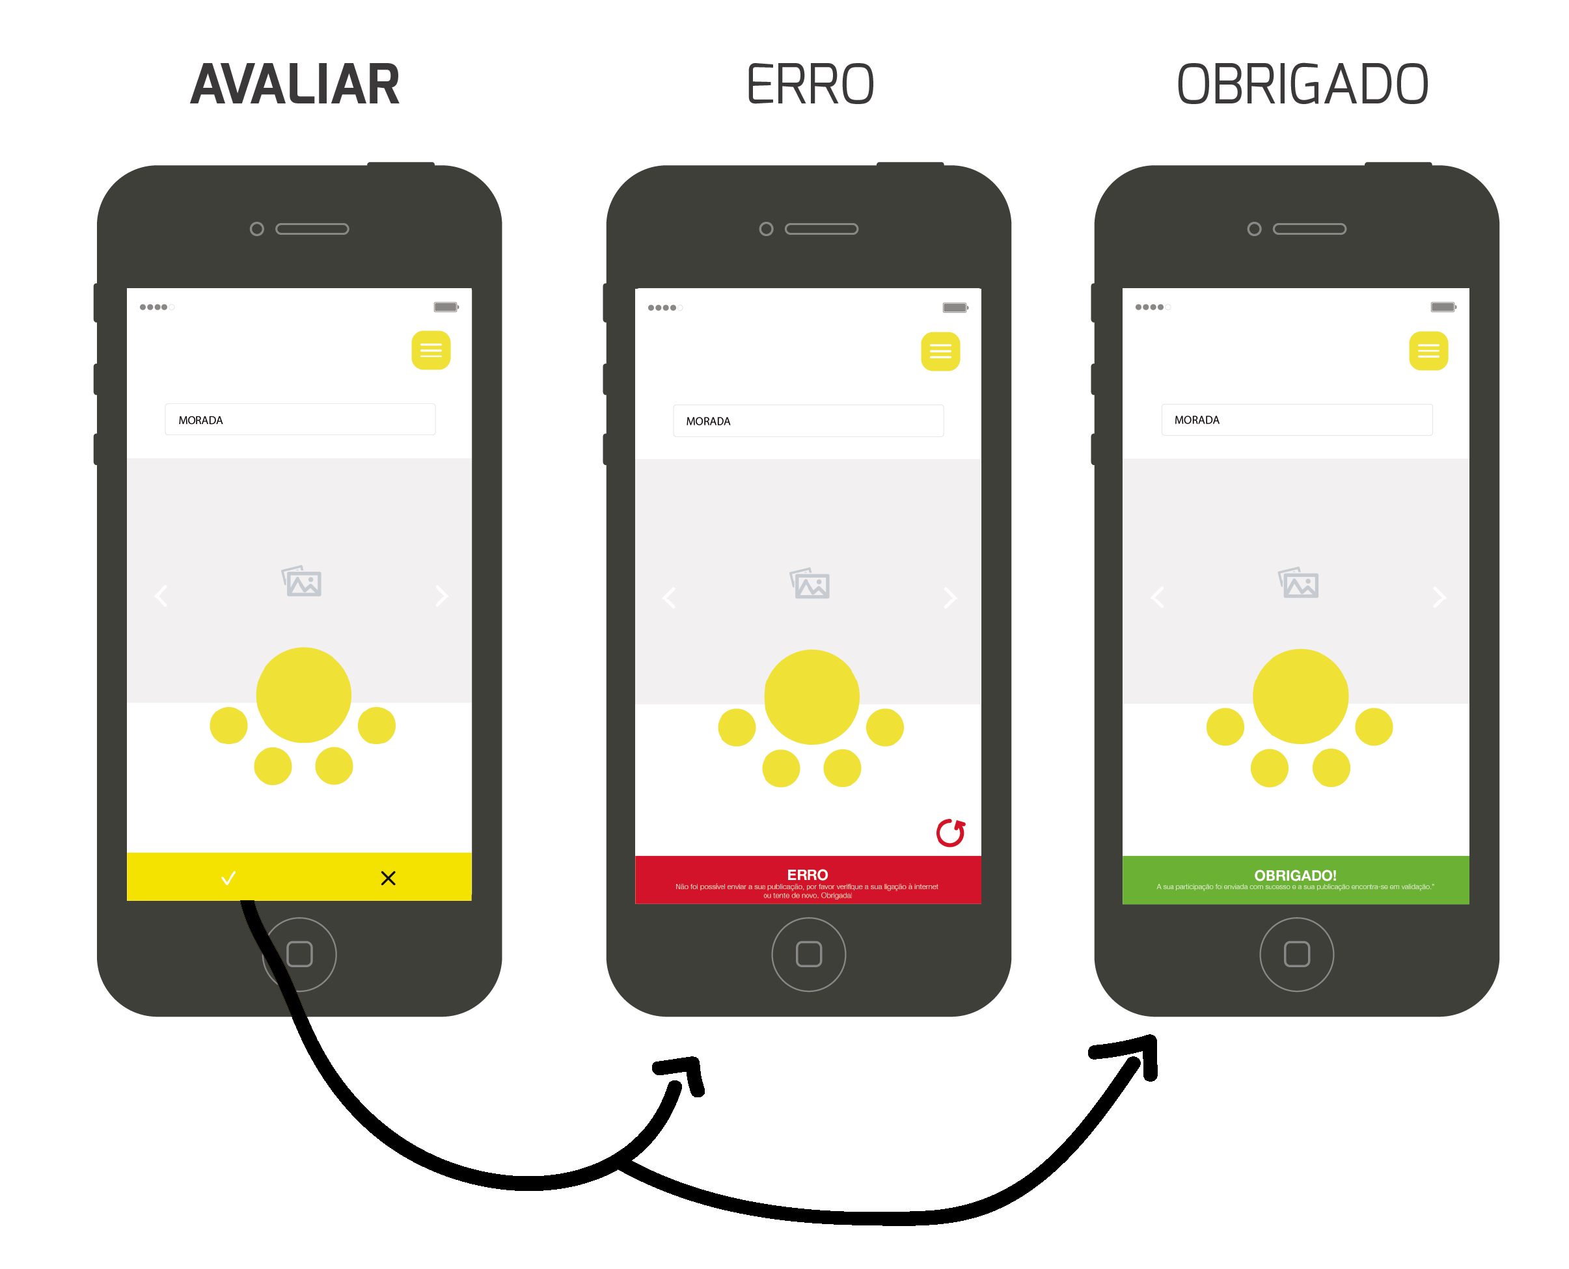
Prototype

Slide 25
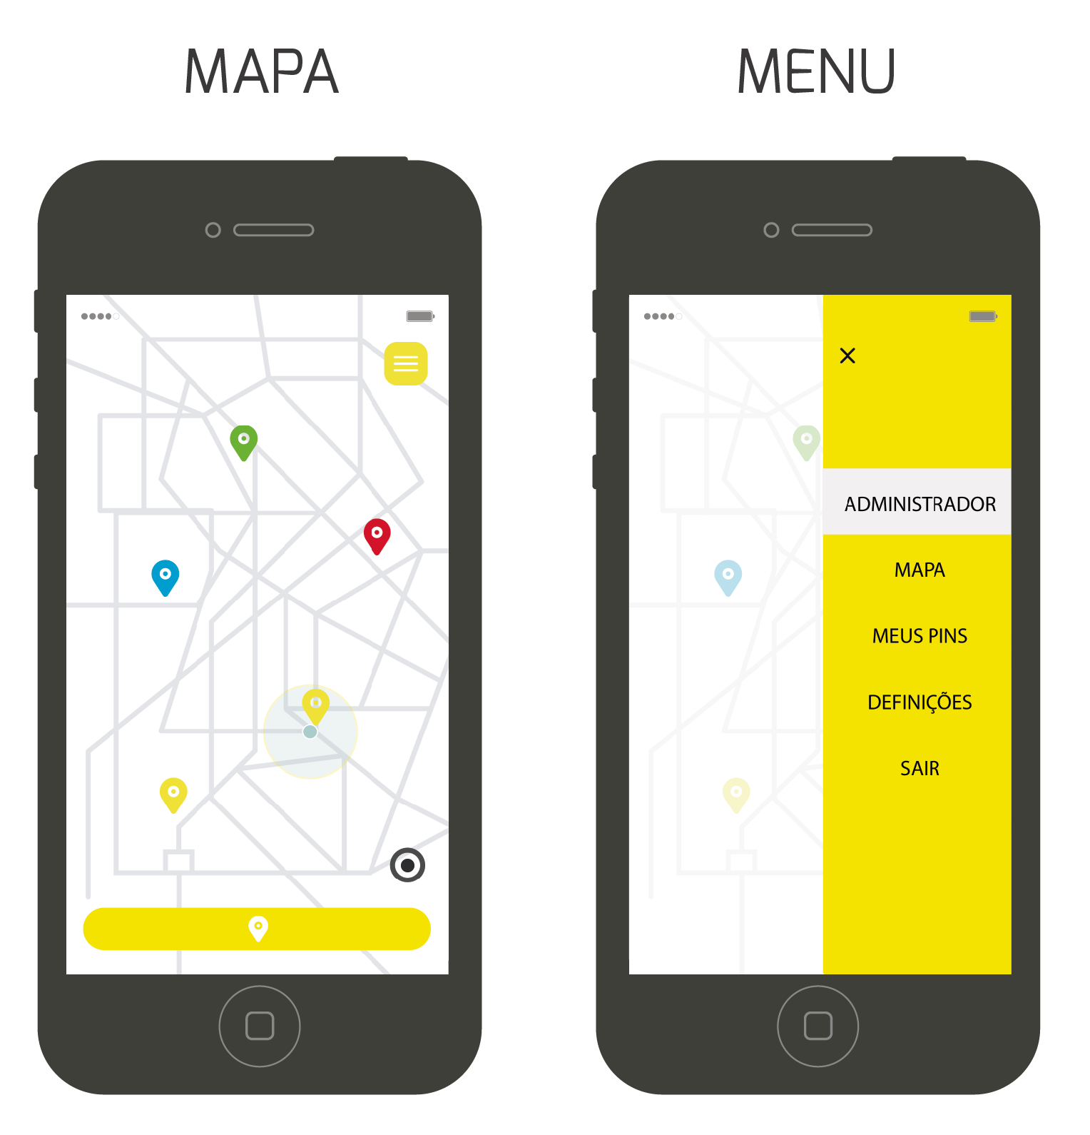
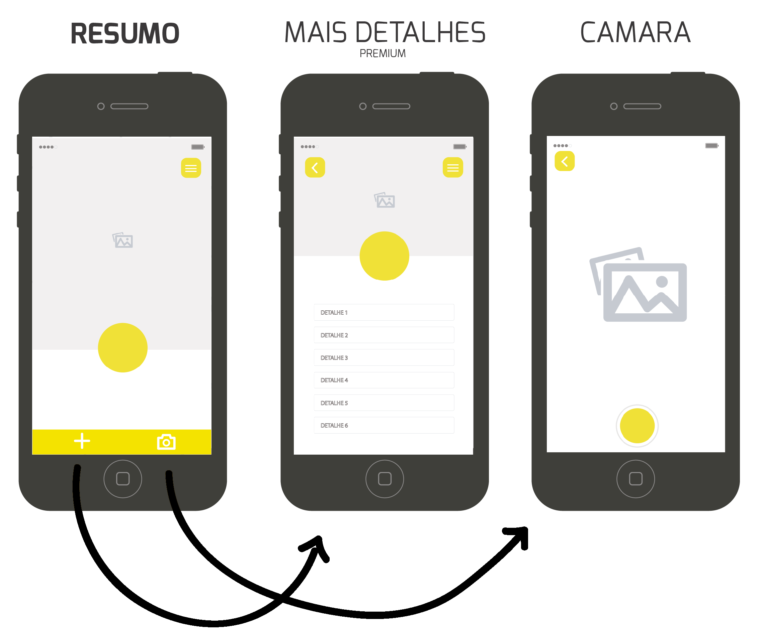
Prototype

Slide 26
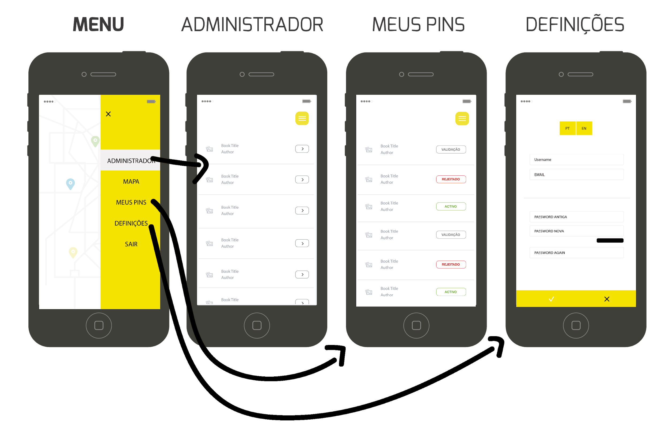
Prototype

Slide 27
Project Update
Conception
_Identify the needs, purpose
and expectations;
_Identify the risks of the project;
_Definition of the stakeholders;
_Presentation of the project team.
_Products:
_Kick-off;
_Initial cronogram.
Plan
_Activities:
_Elaboration of the Schedule;
_Identification and analysis of risks;
_Product:
_Project Plan.

Slide 28
Project Update
Requirements Analysis
_Activities:
_Conduct interviews with managers;
_Products:
_System Requiement Specification;
_Software Architecture Document;
_Acceptance Tests Plan;
_Prototype.
Development
_Activities:
_Construction Phase;
_Functional Phase;
Delivery
_Presentation of the final product.

Slide 29
EFACEC

Slide 30
Product & Problem
In a on-board computer of a railway vehicle there is information to help with driving and meeting the schedule that is intended to be available in a contextualized, intuitive and safe way to the driver.

Slide 31
Business Objective
Interface for the driver with real-time information on the state of the service and the vehicle.
Provide a communication component with the dispatch center regulator and passengers on board the vehicle.

Slide 32
Project Documentation
System Requirements
Operating Systems Restrictions
Technologies
Actors

Slide 33
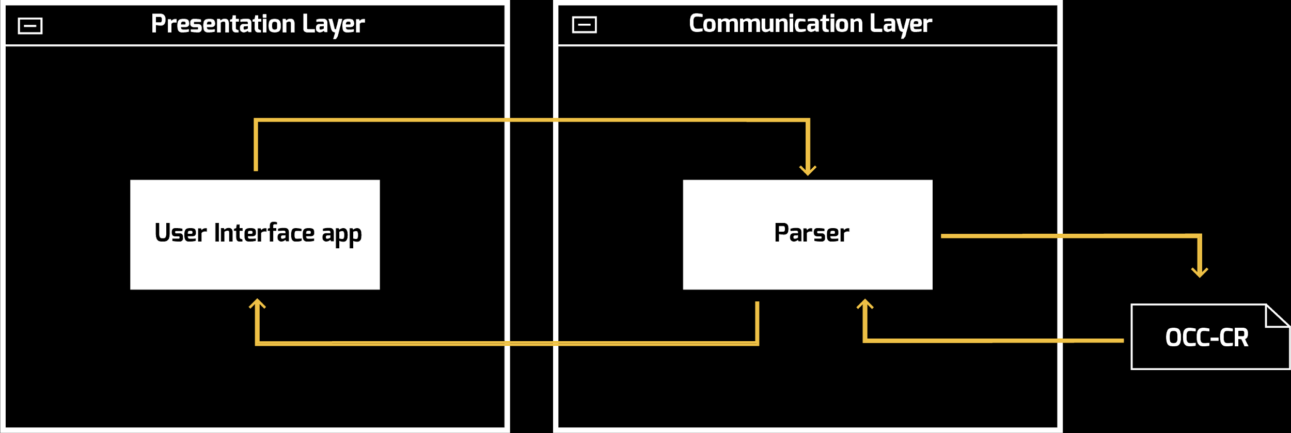
Project Documentation
System Architecture

Slide 34
Project Documentation
Acceptance Test Plan:
Acceptance Tests in User Stories
Validate and adjust AT each sprint
Test after development
Sprint Test report

Slide 35
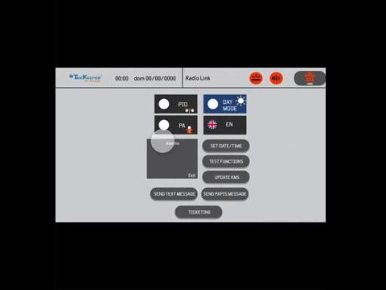
Prototype

Slide 36
Project Update
Sprints with a duration of 2 weeks
Development based on Functionality:
Priority
Estimated weight
Each Sprint review:
Risk Management update
Progress Review
Test Report
Prepare User Stories backlog
Assign work for next Sprint

Slide 37
Talk Desk

Slide 38
Product & Problem
Talkdesk
_Offers a call center solution
_But a bit more than that…
IT departments
_Depend on external services to build their solutions.
_External service failure will result in their service’s underperformance.
_Which will lead to more requests to Helpdesks.

Slide 39
Business Objective
Help IT Helpdesks.
_Specifically, Helpdesk agents.
_ By keeping track of the health of the services used in the company.
_Notifying about occurrences in timely fashion.

Slide 40
Project Documentation
SRS
_Web App
_Dashboard page
_Configuration Page
_Services
_AWS, Heroku, Slack,
Github, Dynamic URL
_Information
_Status
_Reason for status
_Last update date
_Scalable and Available
ATP
_Test cycle phases:
_Conception
_Development
_Control
_Methods
_Functional: Unit, Integration, System and Acceptance Testing
_Non-functional: Stress and Load Testing
_Acceptance Test successful if:
_Developed tests pass
_ Quality Manager approves
_ Client approves

Slide 41
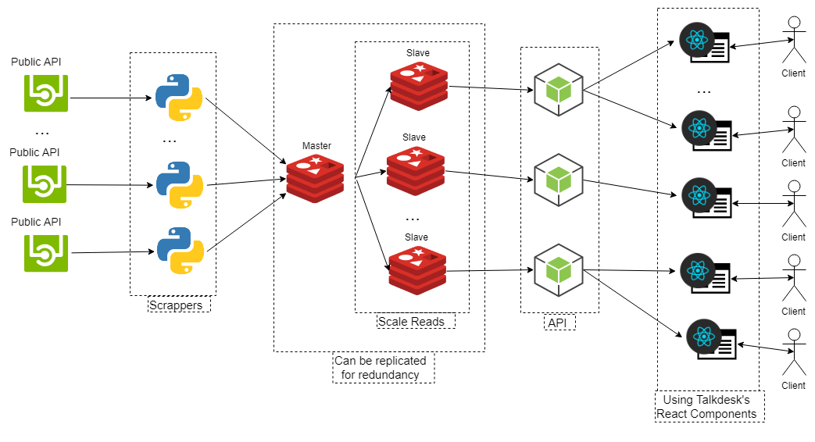
Project Documentation
SAD

Slide 42

Prototype

Slide 43
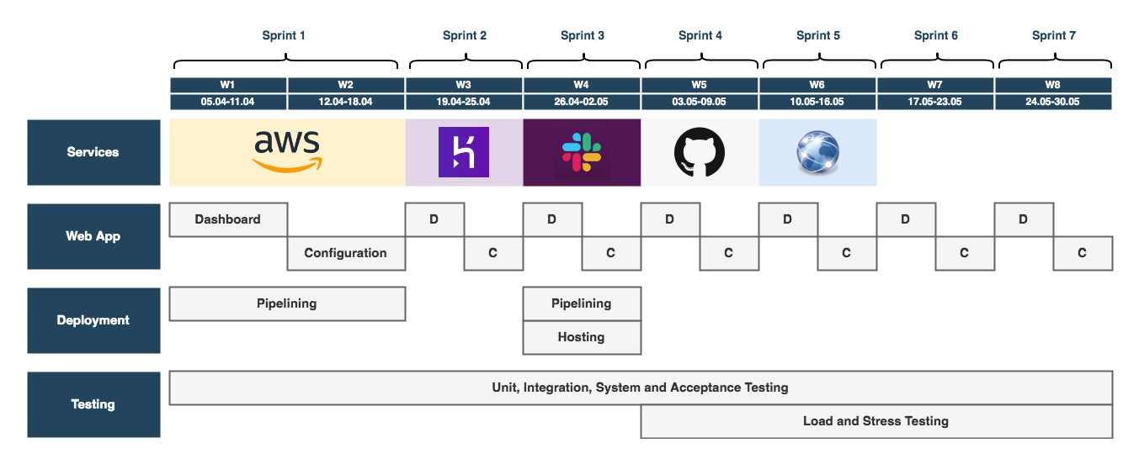
Project Update
Service pipeline of the next few weeks.

